Slide 1
Chapter 1 The Foundations : Logic and Proofs Kenneth H. Rosen 7th edition
Section 1.3 : Propositional Equivalences

Slide 2
Tautology, Contradiction & Contingency
Tautology:
A compound proposition that is always true, no matter what the truth values of the propositional variables that occur in it.
Contradiction:
A compound proposition that is always false is called a contradiction.
Contingency:
A compound proposition that is neither a tautology nor a contradiction is called a contingency.

Slide 3
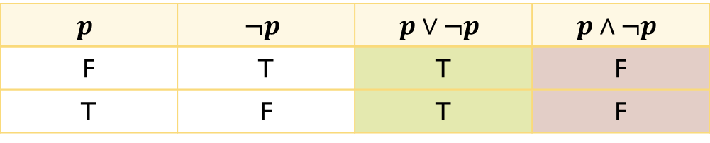
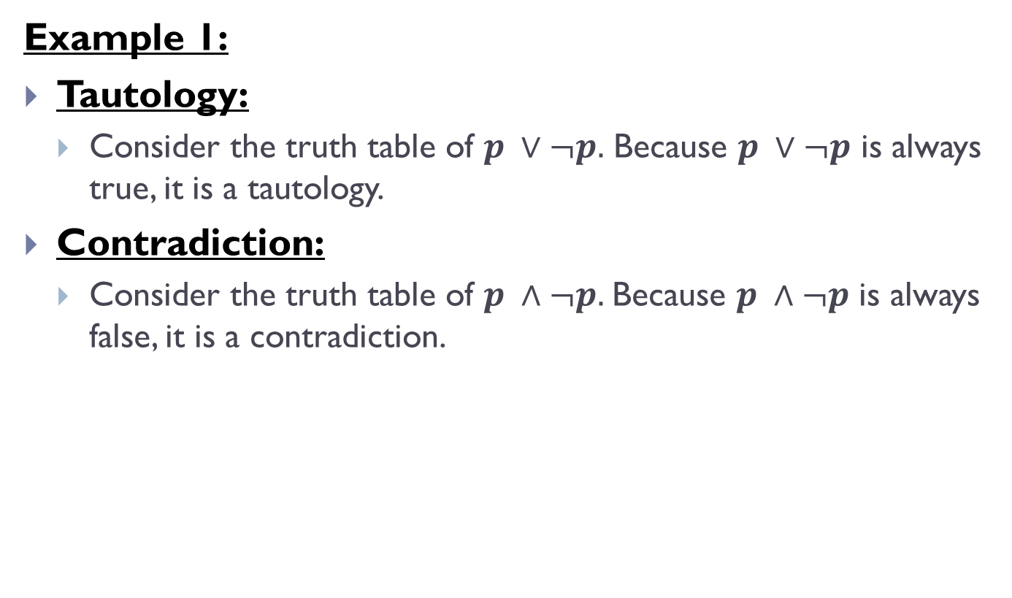
Tautology, Contradiction & Contingency(Contd.)
Example 1:
Tautology:
Consider the truth table of $p ∨¬p.$ Because $p ∨¬p$ is always true, it is a tautology.
Contradiction:
Consider the truth table of $p ∧¬p.$Because $p ∧¬p$ is always false, it is a contradiction.
$$p$$ | $$¬p$$ | $$p∨¬p$$ | $$p∧¬p$$
F | T | T | F
T | F | T | F

Slide 4

Logical Equivalences
Compound propositions that have the same truth values in all possible cases are called logically equivalent.
The compound propositions $p$ and $q$ are called logically equivalent if $p ↔ q$ is a tautology.
The notation $p ≡ q$ denotes that $p$ and $q$ are logically equivalent.

Slide 5
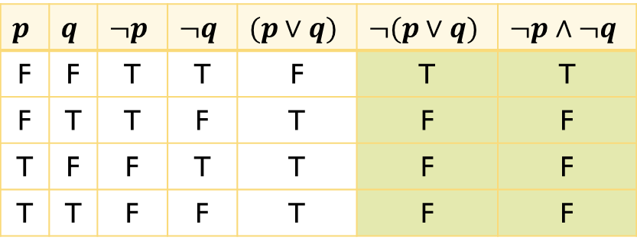
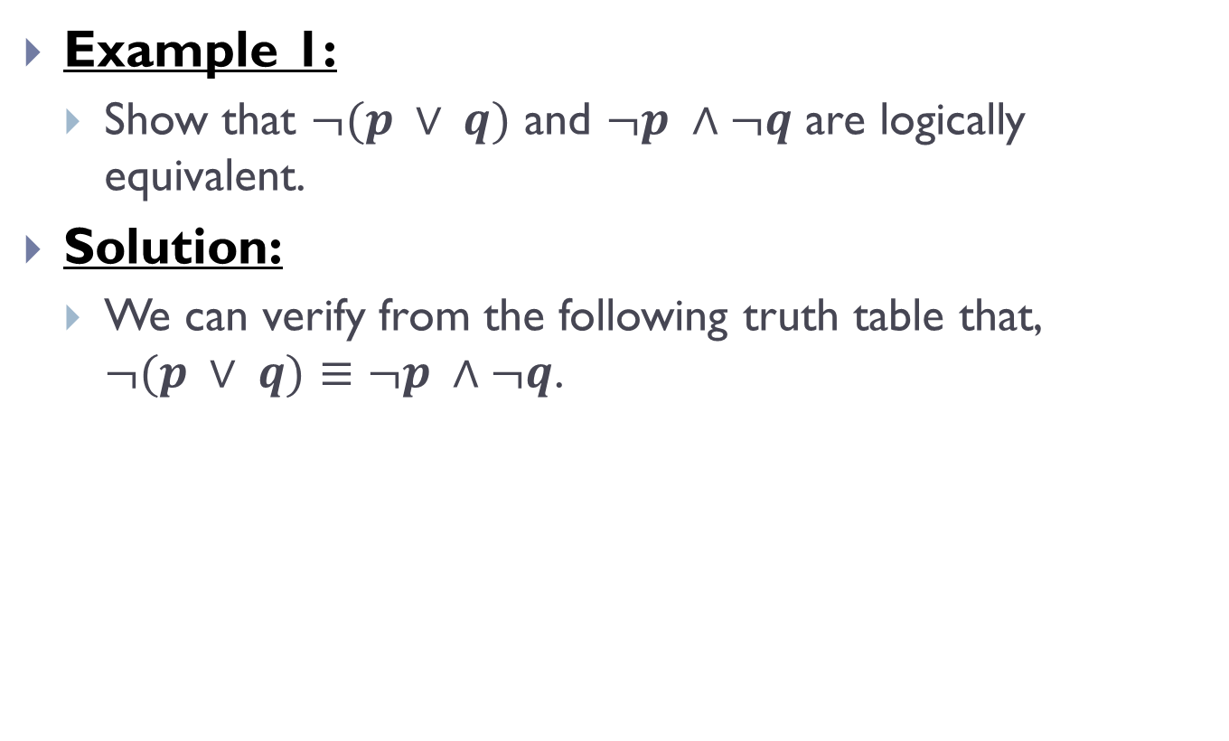
Logical Equivalences(Contd.)
Example 1:
Show that $¬(p ∨ q)$ and $¬p ∧¬q$ are logically equivalent.
Solution:
We can verify from the following truth table that, $¬(p ∨ q)$ $≡$ $¬p ∧¬q$.
$$p$$ | $$q$$ | $$¬p$$ | $$¬q$$ | $$(p∨q)$$ | $$¬(p∨q)$$ | $$¬p∧¬q$$
F | F | T | T | F | T | T
F | T | T | F | T | F | F
T | F | F | T | T | F | F
T | T | F | F | T | F | F

Slide 6

Logical Equivalences(Contd.)
Exercises:
Show that $p → q$ and $¬p ∨ q$ are logically equivalent.
Show that $p ∨ (q ∧ r)$ and $(p ∨ q) ∧ (p ∨ r)$ are logically equivalent.

Slide 7
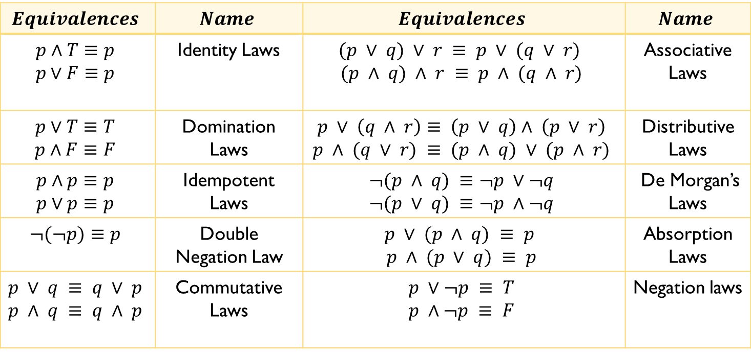
Logical Equivalence Rules
Important rules
$$Equivalences$$ | $$Name$$ | $$Equivalences$$ | $$Name$$
$$p∧T≡p$$ $$p∨F≡p$$ | Identity Laws | $$(p ∨ q) ∨ r ≡ p ∨ (q ∨ r)$$ $$(p ∧ q) ∧ r ≡ p ∧ (q ∧ r)$$ | Associative Laws
$$p∨T≡T$$ $$p∧F≡F$$ | Domination Laws | $$p ∨ \left(q ∧ r\right)≡ \left(p ∨ q\right)∧ \left(p ∨ r\right)$$ $$p ∧ (q ∨ r) ≡ (p ∧ q) ∨ (p ∧ r)$$ | Distributive Laws
$$p∧p≡p$$ $$p∨p≡p$$ | Idempotent Laws | $$¬(p ∧ q) ≡¬p ∨¬q$$ $$¬(p ∨ q) ≡¬p ∧¬q$$ | De Morgan’s Laws
$$¬(¬p)≡p$$ | Double Negation Law | $$p ∨ (p ∧ q) ≡ p$$ $$p ∧ (p ∨ q) ≡ p$$ | Absorption Laws
$$p ∨ q ≡ q ∨ p$$ $$p ∧ q ≡ q ∧ p$$ | Commutative Laws | $$p ∨¬p ≡ T$$ $$p ∧¬p ≡ F$$ | Negation laws

Slide 8
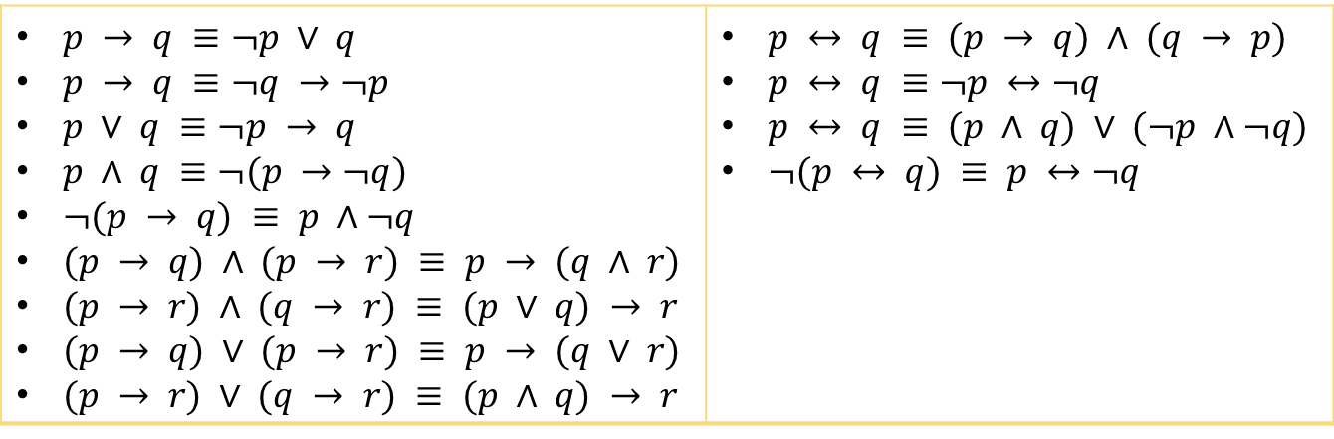
Logical Equivalence Rules(Contd.)
Important Rules Regarding Conditionals
$p → q ≡¬p ∨ q$ $p → q ≡¬q →¬p$ $p ∨ q ≡¬p → q$ $p ∧ q ≡¬(p →¬q)$ $¬(p → q) ≡ p ∧¬q$ $(p → q) ∧ (p → r) ≡ p → (q ∧ r)$ $(p → r) ∧ (q → r) ≡ (p ∨ q) → r$ $(p → q) ∨ (p → r) ≡ p → (q ∨ r)$ $(p → r) ∨ (q → r) ≡ (p ∧ q) → r$ | $p ↔ q ≡ (p → q) ∧ (q → p)$ $p ↔ q ≡¬p ↔¬q$ $p ↔ q ≡ (p ∧ q) ∨ (¬p ∧¬q)$ $¬(p ↔ q) ≡ p ↔¬q$

Slide 9
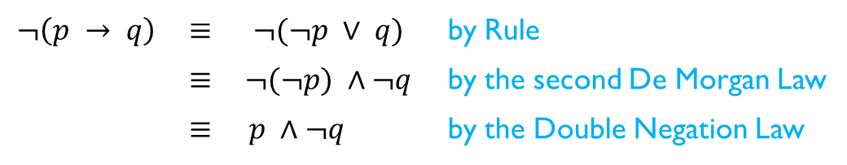

Constructing New Logical Equivalences
Example 1:
Show that $¬(p → q)$ and $p ∧¬q$ are logically equivalent.
Solution:
$$¬\left(p → q\right)$$ | $$≡$$ | $$¬(¬p ∨ q)$$ | by Rule
 | $$≡$$ | $$¬(¬p) ∧¬q$$ | by the second De Morgan Law
 | $$≡$$ | $p ∧¬q$ | by the Double Negation Law

Slide 10
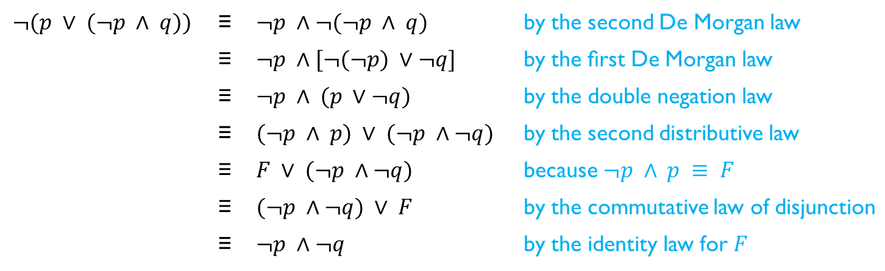

Constructing New Logical Equivalences(Contd.)
Example 2:
Show that $¬(p ∨ (¬p ∧ q))$ and $¬p ∧¬q$ are logically equivalent by developing a series of logical equivalences.
Solution:
$$¬(p ∨ (¬p ∧ q))$$ | ≡ | $$¬p ∧¬(¬p ∧ q)$$ | by the second De Morgan law
 | ≡ | $$¬p ∧[¬(¬p) ∨¬q]$$ | by the ﬁrst De Morgan law
 | ≡ | $$¬p ∧ (p ∨¬q)$$ | by the double negation law
 | ≡ | $$(¬p ∧ p) ∨ (¬p ∧¬q)$$ | by the second distributive law
 | ≡ | $$F ∨ (¬p ∧¬q)$$ | because $¬p ∧ p ≡ F$
 | ≡ | $$(¬p ∧¬q) ∨ F$$ | by the commutative law of disjunction
 | ≡ | $$¬p ∧¬q$$ | by the identity law for $F$

Slide 11
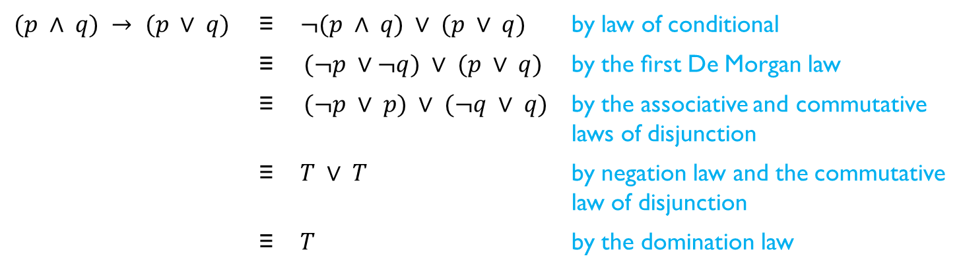

Constructing New Logical Equivalences(Contd.)
Example 3:
Show that $(p ∧ q) → (p ∨ q)$is a tautology.
Solution:
$$(p ∧ q) → (p ∨ q)$$ | ≡ | $$¬(p ∧ q) ∨ (p ∨ q)$$ | by law of conditional
 | ≡ | $$(¬p ∨¬q) ∨ (p ∨ q)$$ | by the ﬁrst De Morgan law
 | ≡ | $$(¬p ∨ p) ∨ (¬q ∨ q)$$ | by the associative and commutative laws of disjunction
 | ≡ | $T ∨ T$ | by negation law and the commutative law of disjunction
 | ≡ | $$T$$ | by the domination law

Slide 12
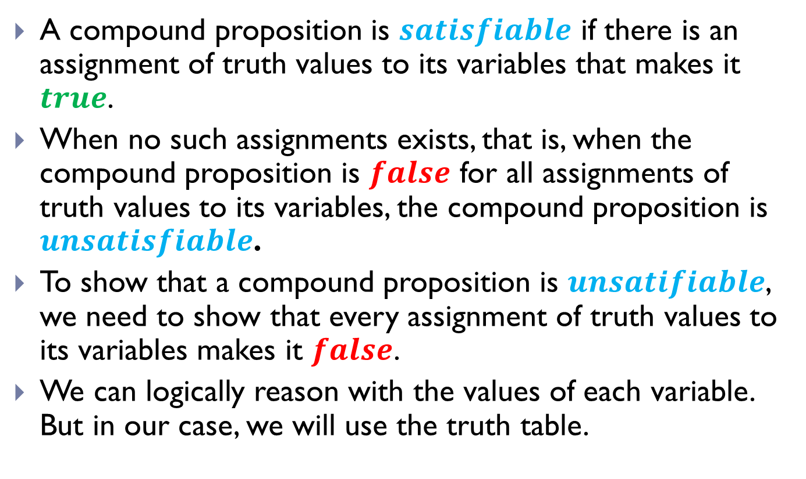
Propositional Satisfiability
A compound proposition is $satisfiable$ if there is an assignment of truth values to its variables that makes it $true$.
When no such assignments exists, that is, when the compound proposition is $false$ for all assignments of truth values to its variables, the compound proposition is $unsatisfiable$.
To show that a compound proposition is $unsatifiable$, we need to show that every assignment of truth values to its variables makes it $false$.
We can logically reason with the values of each variable. But in our case, we will use the truth table.

Slide 13

Propositional Satisfiability(Contd.)
Example 1:
Determine the satisfiability of the compound proposition
$\left(p ∨¬q\right)∧ \left(q ∨¬r\right)∧\left(r ∨¬p\right)$

Slide 14
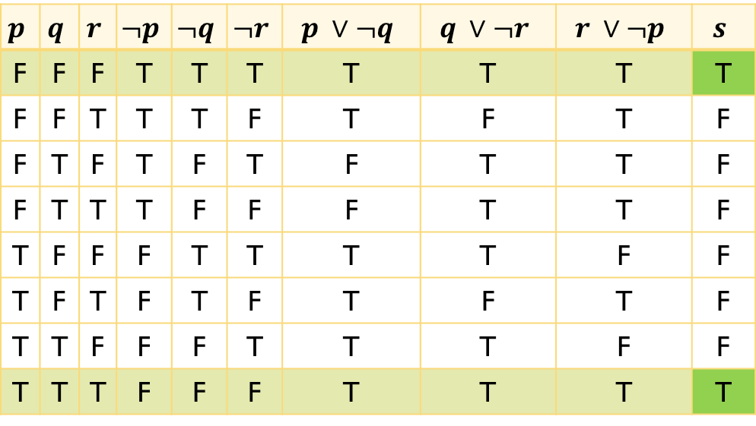

Propositional Satisfiability(Contd.)
Solution:
Let $s=\left(p ∨¬q\right)∧ \left(q ∨¬r\right)∧\left(r ∨¬p\right)$
$$p$$ | $$q$$ | $$r$$ | $$¬p$$ | $$¬q$$ | $$¬r$$ | $$p ∨¬q$$ | $$q ∨¬r$$ | $$r ∨¬p$$ | $$s$$
F | F | F | T | T | T | T | T | T | T
F | F | T | T | T | F | T | F | T | F
F | T | F | T | F | T | F | T | T | F
F | T | T | T | F | F | F | T | T | F
T | F | F | F | T | T | T | T | F | F
T | F | T | F | T | F | T | F | T | F
T | T | F | F | F | T | T | T | F | F
T | T | T | F | F | F | T | T | T | T

Slide 15

Propositional Satisfiability(Contd.)
Since there is at least one combination of input for the variables $p,q,r$ of the compound proposition, which gives a true value for the compound proposition $s,$we can say that the $s$ is satisfiable.

Slide 16

Propositional Satisfiability(Contd.)
Exercises:
Determine the satisfiability of each of the compound propositions
$(p ∨ q ∨ r) ∧ (¬p ∨¬q ∨¬r)$
$(p ∨¬q) ∧ (q ∨¬r) ∧ (r ∨¬p) ∧(p ∨ q ∨ r) ∧ (¬p ∨¬q ∨¬r)$

Slide 17
THE END

